Slide 1
INFRASTRUCTURE AS A CODE

Slide 2
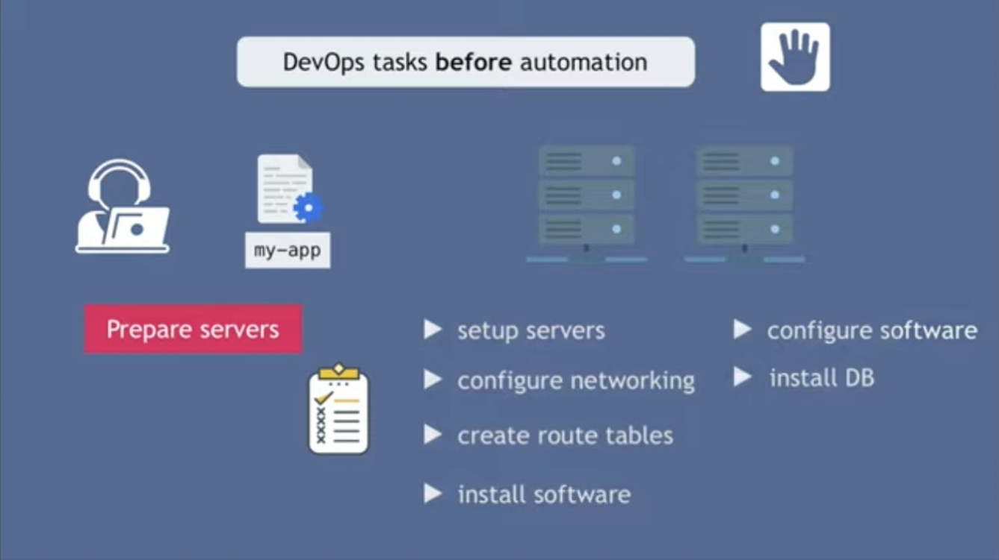

Slide 3
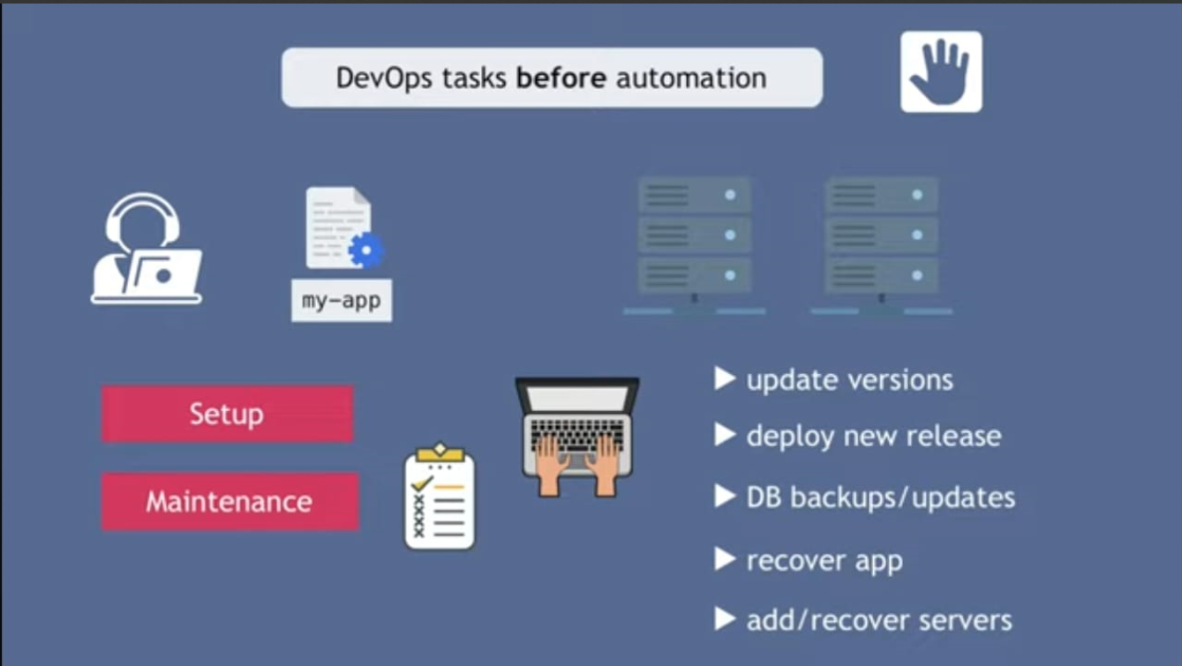

Slide 4
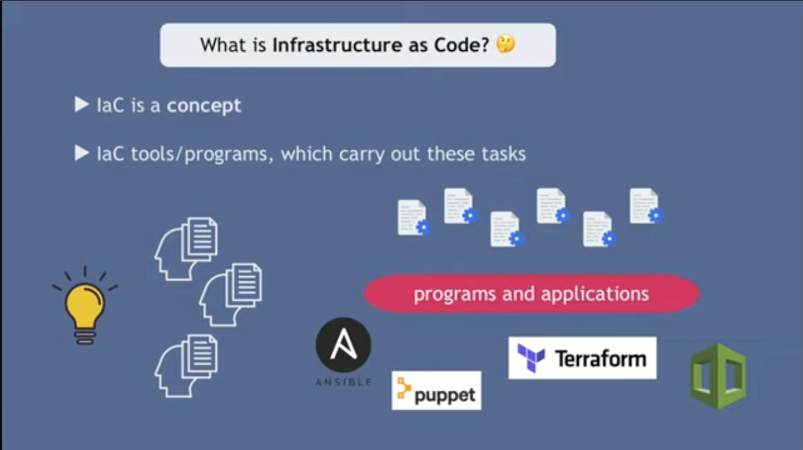

Slide 5



Introduction to Infrastructure as Code
Infrastructure as Code (IaC) is a pivotal concept in modern software development, enabling the management of infrastructure through code and automation.
It revolutionizes the way organizations build, deploy, and manage their IT infrastructure, bringing agility, scalability, and consistency to the entire process.
By representing infrastructure configurations as code, IaC allows for version control, testing, and rapid provisioning, resulting in reduced manual errors and improved operational efficiency.

Slide 6
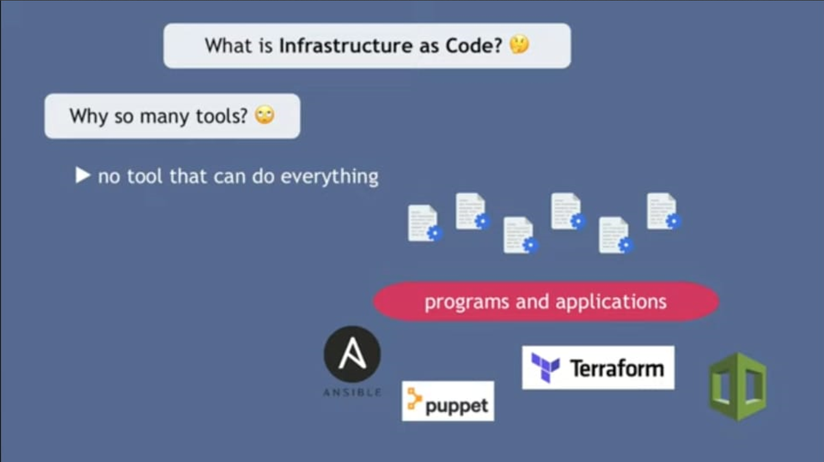

Slide 7
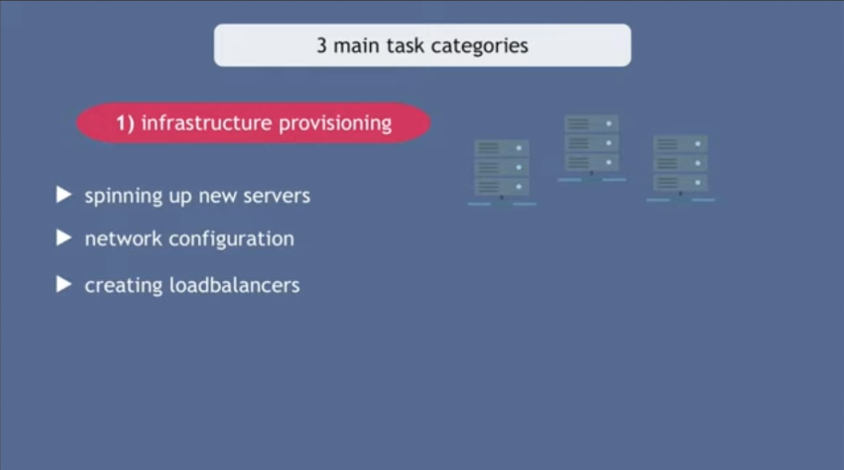

Slide 8
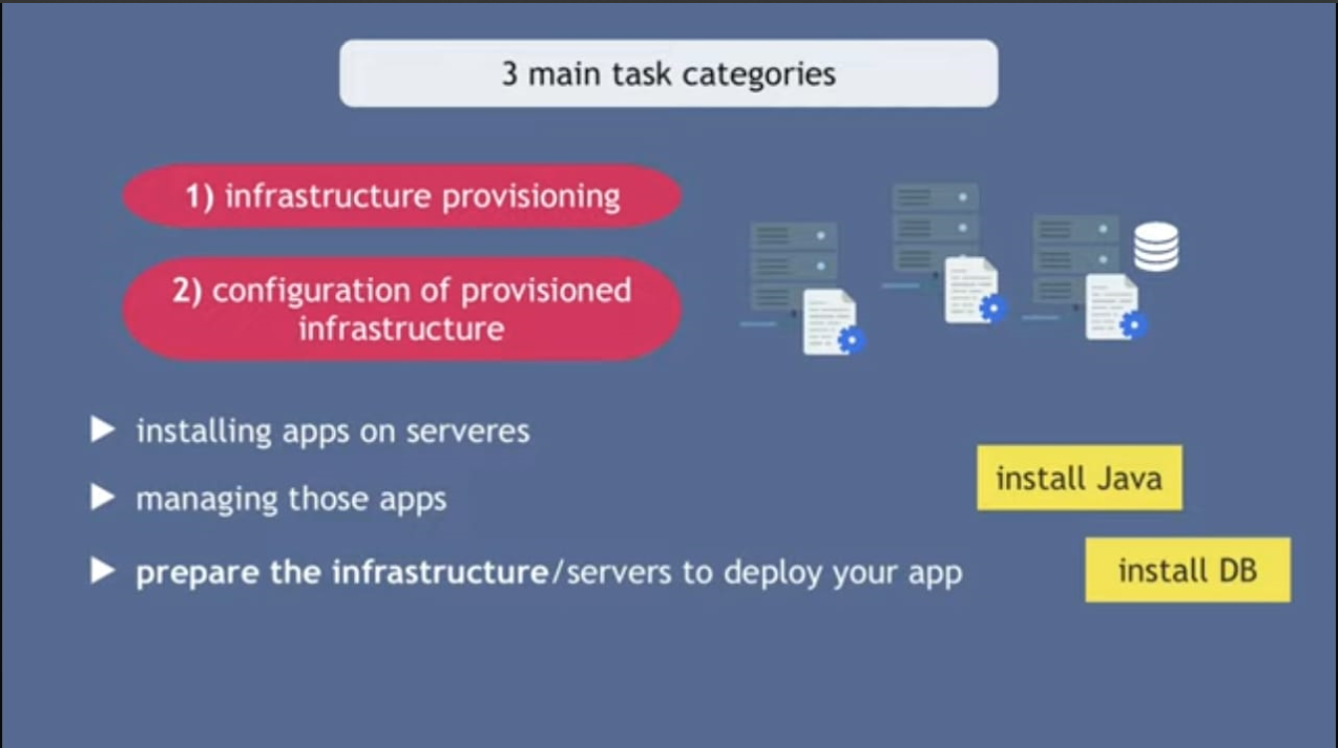

Slide 9
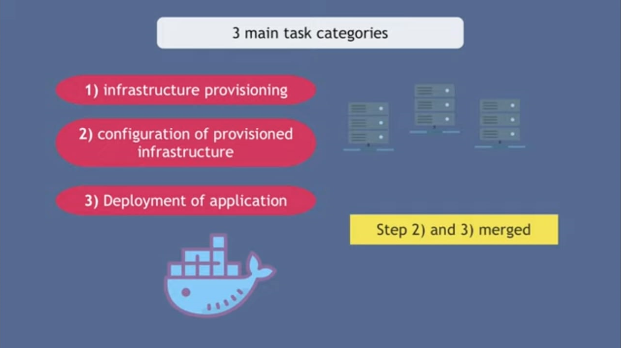

Slide 10


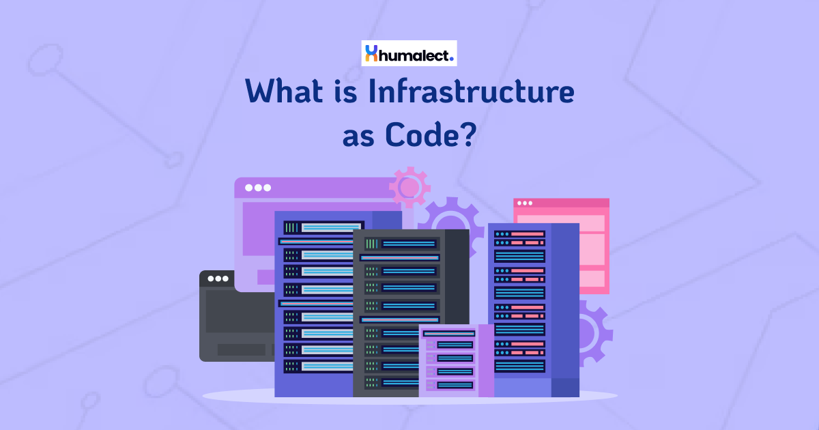
Importance and Consistency of IaC
Scalability and Efficiency
Infrastructure as code (IaC) plays a pivotal role in achieving scalability and efficiency within an organization's IT environment. By defining infrastructure through code, it enables the automation of repetitive tasks, leading to greater operational efficiency and the ability to rapidly scale resources up or down as needed

Slide 11

Importance and Consistency of Infrastructure as Code
Version Control and Documentation
One of the key benefits of IaC is the ability to apply version control to infrastructure configurations, ensuring that any changes made are tracked, documented, and reversible. This approach promotes consistency, reduces errors, and provides a clear audit trail for all modifications, enhancing the overall reliability of the infrastructure.

Slide 12
Importance and Consistency of Infrastructure as Code
Standardization and Compliance
By codifying infrastructure, organizations can enforce standardized configurations and security policies across their IT ecosystem. This promotes consistency in deployment and operations, while also facilitating compliance with regulatory requirements, industry standards, and best practices.

Slide 13


Importance and Consistency of Infrastructure as Code
Collaboration and Knowledge Sharing
Implementing IaC fosters collaboration among teams by allowing infrastructure configurations to be shared and reviewed in a transparent manner. It encourages knowledge sharing and enables teams to work cohesively on infrastructure projects, leading to improved communication and alignment across the organization

Slide 14
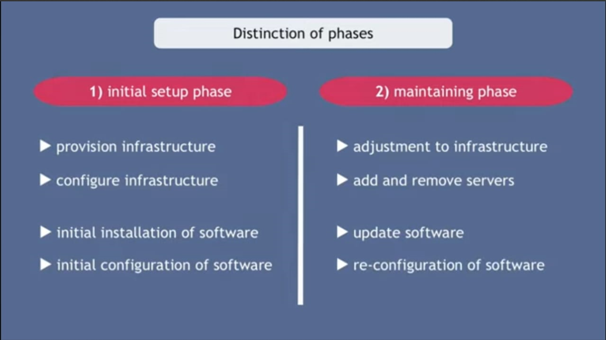

Slide 15

Push vs Pull Approach in Infrastructure as Code
Push Model | Pull Model
In the push model of infrastructure as code, the central management server initiates and controls the deployment process. It pushes configuration changes or updates to the target infrastructure. | The pull model is based on the infrastructure components periodically pulling or fetching configuration updates from a central repository or server.
This model provides a centralized approach to managing and updating infrastructure | . This model is often associated with a more decentralized approach, where the infrastructure nodes autonomously decide when to update their configurations

Slide 16
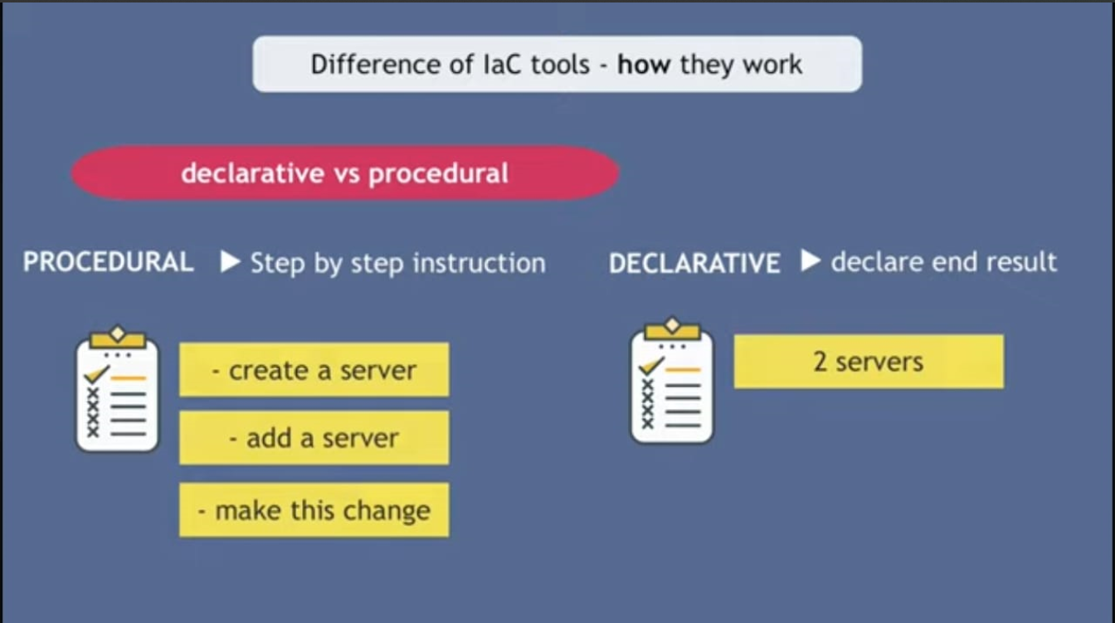

Slide 17
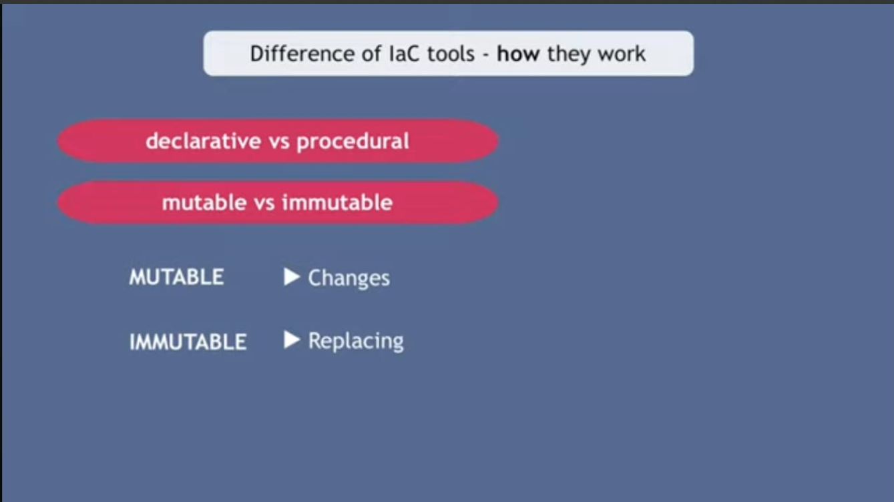

Slide 18
Benefits of Infrastructure as Code
Scalability | Infrastructure as code enables teams to easily scale resources up or down based on demand, allowing for efficient resource allocation and cost savings.
Consistency | By defining infrastructure configurations in code, organizations can ensure uniformity across environments, reducing the risk of configuration drift and minimizing errors.
Version Control | Infrastructure code can be managed using version control systems, providing a historical record of changes, facilitating collaboration, and enabling rollback to previous states if needed
Automation | IaC allows for the automation of provisioning, configuration, and orchestration tasks, leading to faster deployments, improved reliability, and decreased manual effort.

Slide 19

Plugin-based architecture in infrastructure as code
Plugin-based architecture in infrastructure as code allows for modularity and extensibility.
It enables the integration of custom and third-party plugins for seamless functionality.
This approach promotes flexibility and adaptability in managing diverse infrastructure components.

Slide 20




Key Features of Plugin-based architecture
Flexibility
Modularity
Scalability
Extensibility
Plugin-based architecture allows for flexible and customizable solutions.
Dividing the infrastructure into individual components for easy management.
Easily scale up or down based on changing requirements and workloads.
Ability to add new functionalities or features without rebuilding the entire system.

Slide 21
Advantages of using a plugin-based architecture
Flexibility
Scalability
Reusability
Plugin-based architecture allows for flexible and modular designs, making it easier to adapt to changing requirements.
It enables easy scaling by adding or removing plugins based on the specific needs of the infrastructure.
Plugins can be reused across different projects, saving time and effort in development and maintenance.

Slide 22

Challenges in implementing a plugin-based architecture
1
Complex Integration
Integrating plugins with existing systems can be complex and time-consuming.
2
Version Control
Maintaining version control for multiple plugins can become challenging.
3
Security Concerns
Ensuring the security of the plugin ecosystem and avoiding vulnerabilities.

Slide 23
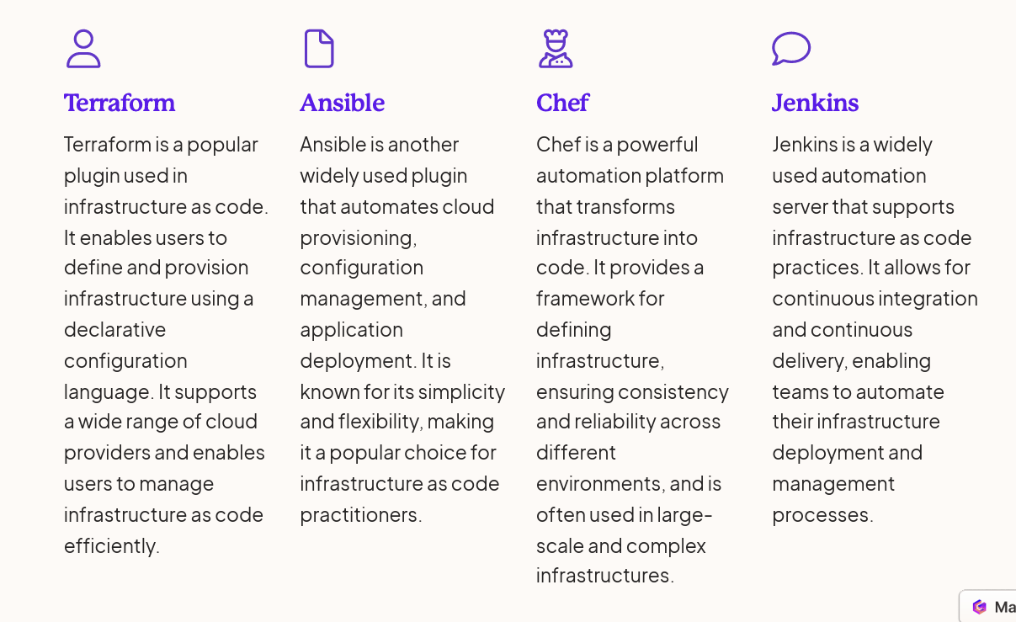
Examples of Popular plugin-based architecture

Slide 24
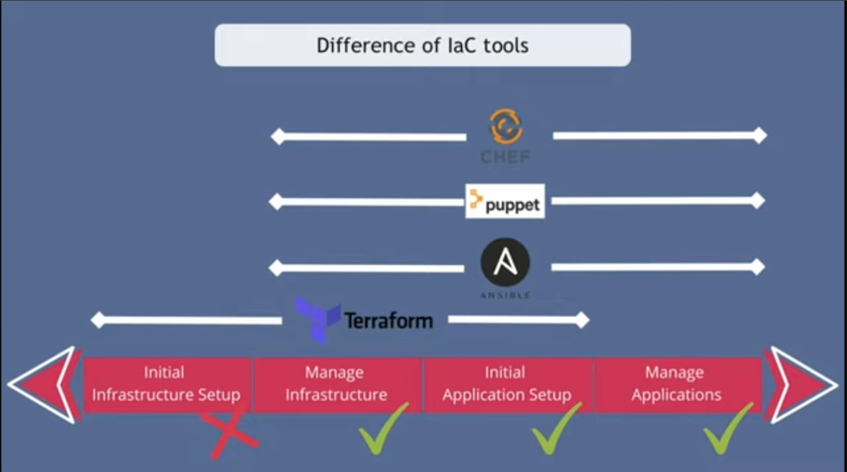

Slide 25
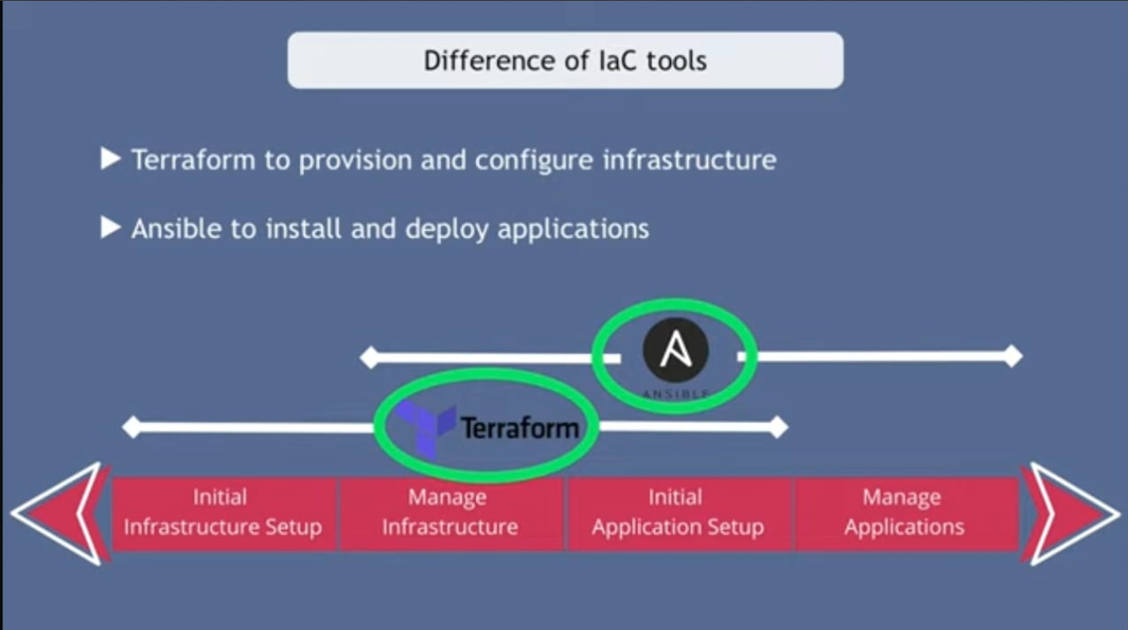

Slide 26
Best practices for designing a plugin-based architecture
Modularity
1
Break down functionality into independent modules
Standardized Interfaces
2
Define clear and consistent interfaces for plugins
Version Control
3
Implement version control for plugins to track changes
When designing a plugin-based architecture, it's crucial to prioritize modularity, enabling the breakdown of functionality into independent modules. Standardizing interfaces for plugins ensures clear communication, while implementing version control allows tracking changes in plugins over time.

Slide 27
Conclusion and key takeaways
Efficiency
Scalability
Infrastructure as code improves efficiency by automating manual processes and reducing human errors.
It enables easy scalability by allowing for the quick provisioning and deployment of resources.
Consistency
Version Control
Consistent infrastructure across environments ensures reliable and predictable outcomes.
Version control brings the benefits of tracking changes and rollbacks to infrastructure.

Slide 28

Quiz Time

Slide 29
What is Infrastructure as Code (IaC)?
A. A programming language
B. A methodology for managing and provisioning infrastructure through code
C. A hardware component
D. A networking protocol

Slide 30
Why is Infrastructure as Code important?
A. It reduces the need for skilled IT professionals
B. It enhances security by keeping infrastructure configurations in text files
C. It eliminates the need for documentation
D. It only works in cloud environments

Slide 31
Which term refers to the practice of keeping infrastructure in a defined state through code?
A. Configuration as Code (CaC)
B. Infrastructure as a Service (IaaS)
C. DevOps as Code (DaC)
D. Infrastructure as Code (IaC)

Slide 32
What is the primary goal of Infrastructure as Code in terms of consistency?
A. To introduce variability in infrastructure configurations
B. To maintain a consistent and reproducible infrastructure state
C. To make frequent and unpredictable changes
D. To increase infrastructure complexity

Slide 33
In the context of IaC, what does "Push" deployment mean?
A. Changes are automatically applied to the infrastructure
B. Changes are manually triggered by a user
C. Changes are pulled from a central repository
D. Changes are only applied to the development environment

Slide 34
Which of the following best describes a "Pull" deployment in Infrastructure as Code?
A. Changes are manually triggered by a user
B. Changes are automatically applied to the infrastructure
C. Changes are pulled from a central repository
D. Changes are only applied to the production environment

Slide 35
What is a key benefit of Infrastructure as Code?
A. Increased manual intervention in deployments
B. Reduced collaboration between development and operations teams
C. Improved scalability and agility
D. Slower response to changes in the environment

Slide 36
Which statement accurately describes a plugin-based architecture in the context of IaC tools?
A. It limits extensibility and flexibility
B. It allows only one specific programming language for scripts
C. It enables the integration of additional functionalities through plugins
D. It focuses solely on infrastructure visualization

Slide 37
In IaC, what is a common disadvantage associated with using imperative languages for defining infrastructure?
A. Increased readability and maintainability
B. Limited expressiveness and difficulty in understanding the desired state
C. Improved collaboration among team members
D. Easier adaptation to changes in infrastructure requirements

Slide 38
Which cloud providers typically support Infrastructure as Code practices?
A. Only on-premises data centers
B. Only public clouds
C. Both public and private clouds
D. Infrastructure as Code is not applicable to cloud environments

Slide 39
Answers
1.B | 2.B | 3.C | 4.B | 5.B
6.C | 7.C | 8.C | 9.B | 10.C

Slide 40

Thank You
Thank You

